Slide 1
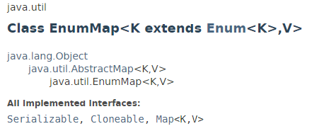
EnumMap
The java.util.EnumMap class is a specialized Map implementation for use with enum keys.
All of the keys in an enum map must come from a single enum type that is specified, explicitly or implicitly, when the map is created.
Enum maps are maintained in the natural order of their keys.
EnumMap is not synchronized.If multiple threads access an enum map concurrently, and at least one of the threads modifies the map, it should be synchronized externally.

Slide 2
EnumMap
https://docs.oracle.com/javase/8/docs/api/index.html?java/util/EnumMap.html

